Slide 1
AUTHENTICATION OF PRODUCT & COUNTERFEITS DETECTION USING BLOCKCHAIN
SUBMITTED BY SUPERVISOR
PRAYAG DEY (10271022020) Mrs. ARPITA NATH
ANANYA KUNDU (10271022026) (ASSISTANT PROFESSOR)
SUDIPA BISWAS (10271022027)

Slide 2
DESCRIPTION OF THE PROJECT
PROBLEM STATEMENT
Authentication of products and identification of counterfeits without third-party involvement
APPROACH TO THE SOLUTION
We are proposing a decentralized app so that the consumers don't have to rely on the word of mouth of the seller but the product itself.
WHY BLOCKCHAIN?
Blockchain technology is immutable (Secure).
TECHNOLOGIES INVOLVED
Solidity, React, Web3.js, Truffle, MetaMask, Ganache

Slide 3
DETAILS OF TECHNOLOGIES
Solidity:- Programming Language used for creating smart contracts for Ethereum blockchain.
React.js:- A front-end JavaScript library for building user interfaces based on components.
Web3.js:- A collection of libraries that allow you to interact with a local or remote Ethereum node, using a HTTP or IPC connection.
Truffle:- Framework for compilation and deployment of smart contracts.
MetaMask:- A cryptocurrency wallet used to interact with the Ethereum blockchain.
Ganache:- A personal blockchain for Ethereum application development.

Slide 4
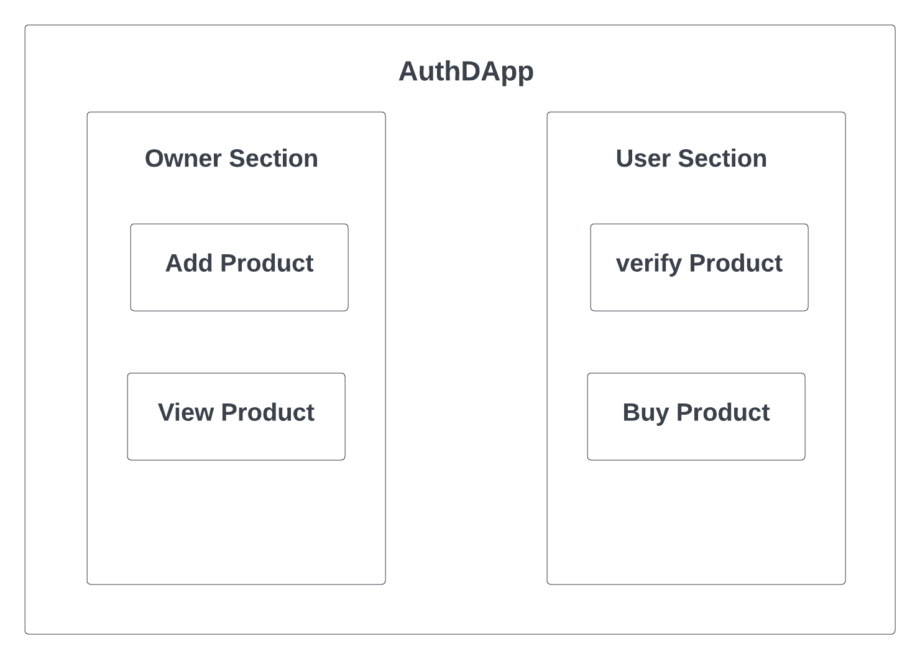
DESCRIPTION OF THE SOLUTION
User can verify the product using the product ID and can also buy it. (without any third-party involvement
Owner can add a new product and also view it.

Slide 5
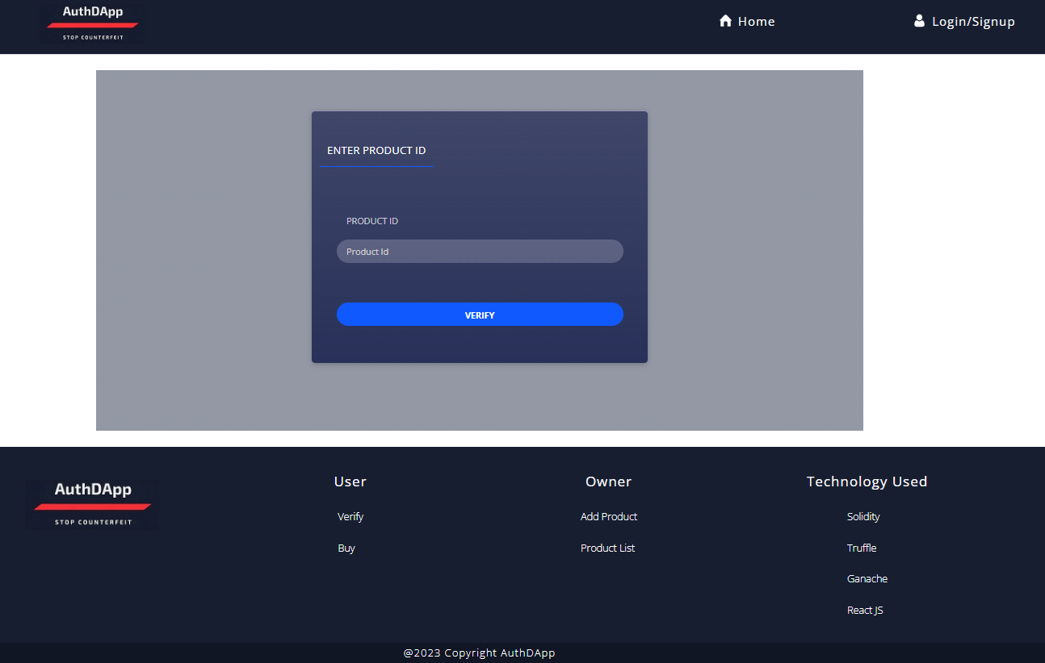
WORKING PROTOTYPE
HOME PAGE

Slide 6
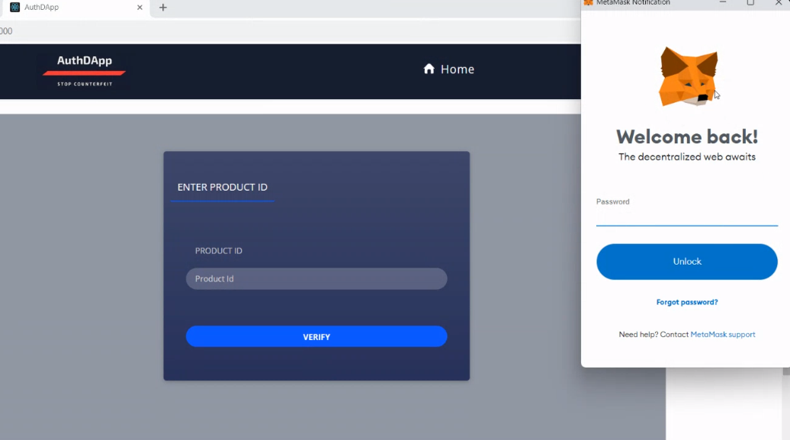
LOG IN SCENARIO

Slide 7
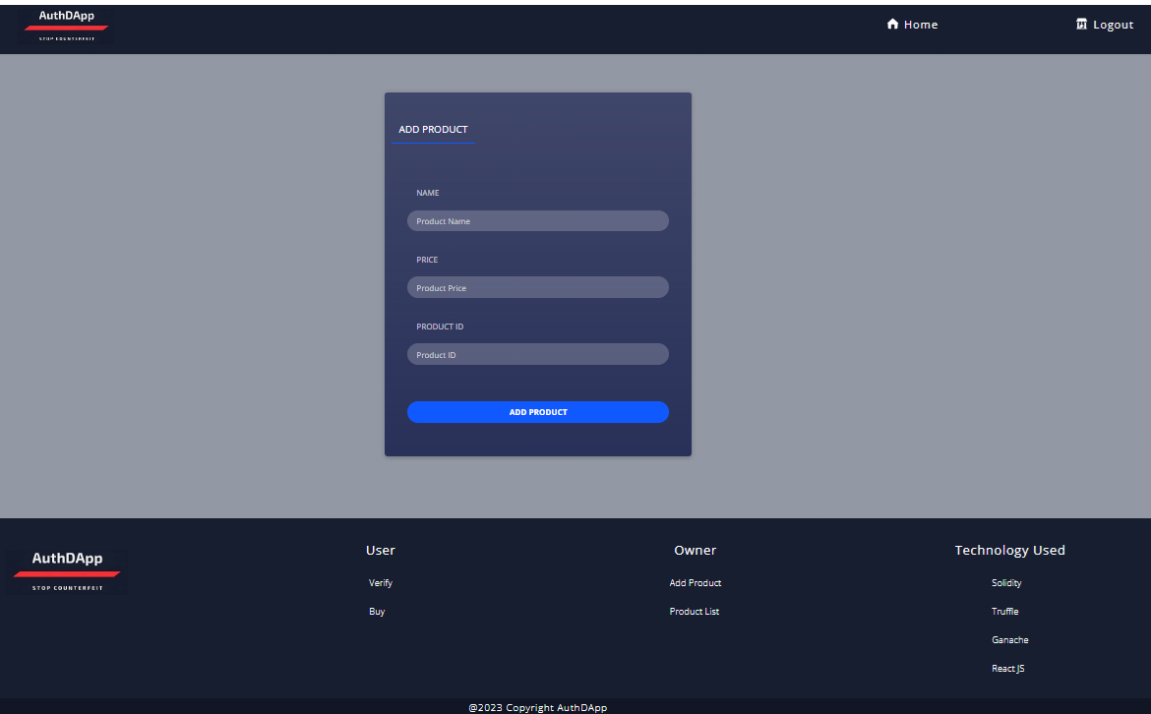
ADD PRODUCT PAGE

Slide 8
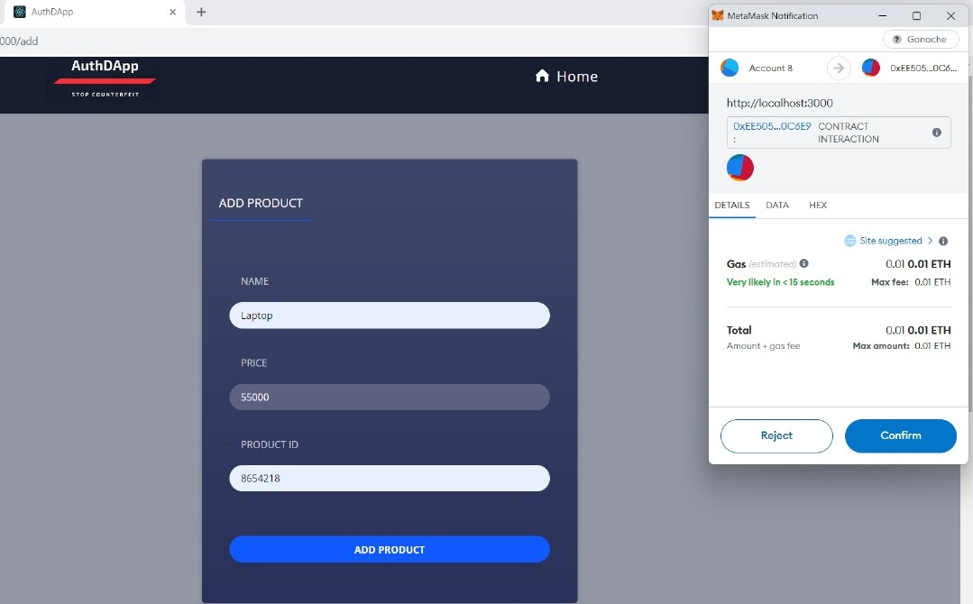
PRODUCT ADDING SCENARIO

Slide 9
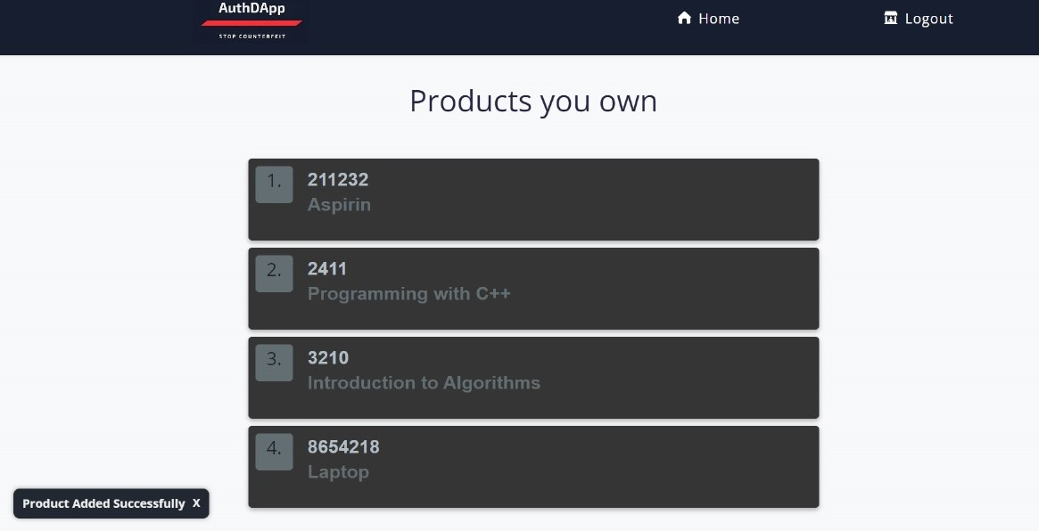
PRODUCT LIST

Slide 10
PRODUCT VERIFY PAGE

Slide 11
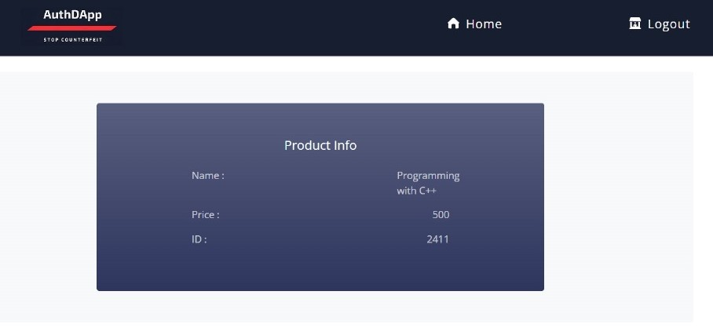
PRODUCT INFO (VERIFYING SCENARIO)

Slide 12
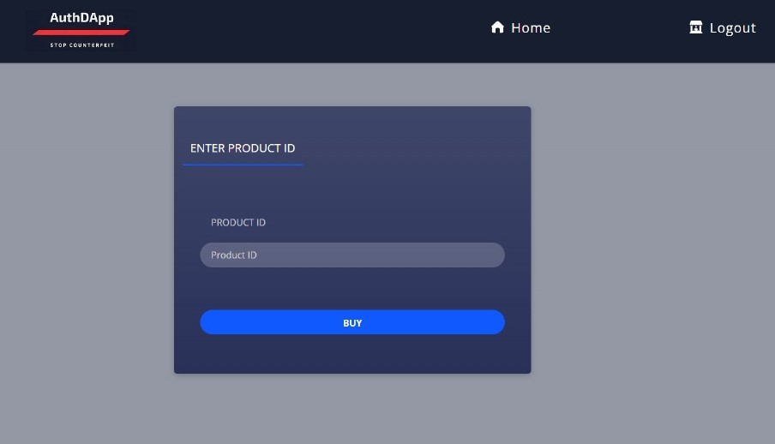
PRODUCT BUY PAGE

Slide 13
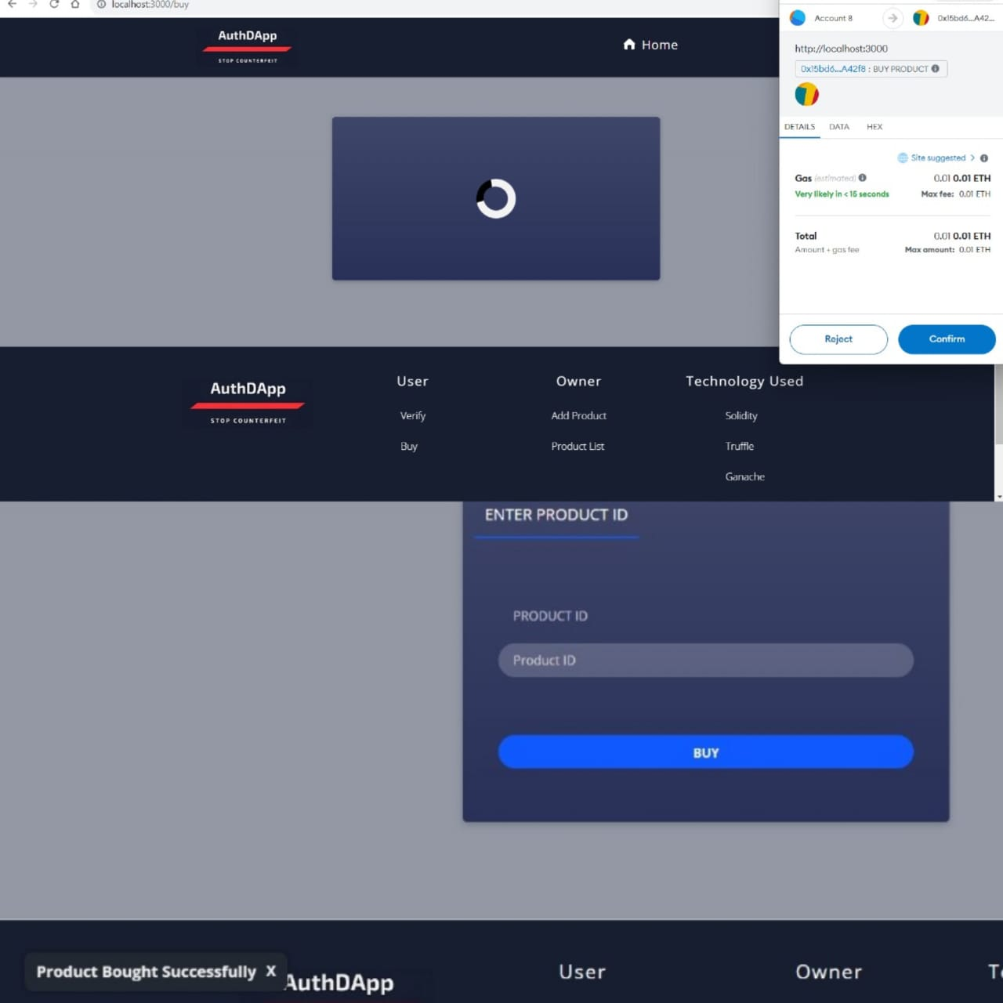
PRODUCT BUYING SCENARIO

Slide 14
LIMITATIONS & CONSIDERATIONS
Integration Challenges
Scalability
Costs
Smart Contract Vulnerabilities
Security Vulnerabilities
Local Blockchain Infrastructure Limitation

Slide 15
FUTURE SCOPE
Exploration of potential advancements, including integration with AI and IoT devices.
Enhancements in user experience and interfaces.
Consideration of interoperability with other blockchain networks.
Possible integration of a ‘Seller Section’.
Generation of a distinct QR code for each product.

Slide 16
CONCLUSION
Revolutionary Solution
Enhancing Supply Chain Security
User-Centric Approach
Future Innovation and Collaboration

Slide 17
THANK YOU

